Slide 1
UT & TDD Seminar
Presentation

Slide 2
Organization
University of Oulu, in the framework of TEKES’ FIDIPRO ESEIL project
ESEIL = Experimental Software Engineering Industry Lab
Participants
Universidad Politécnica de Madrid
Carnegie Mellon University
Finnish companies: FSecure, Elektrobit (the most active) and several more
Others? → yourselves, Universidad Politécnica de Valencia, Army University Ecuador….
Director: Natalia Juristo

Slide 3
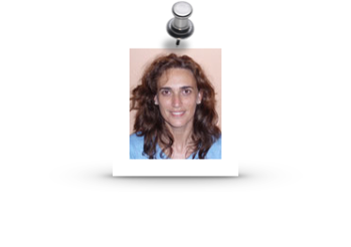
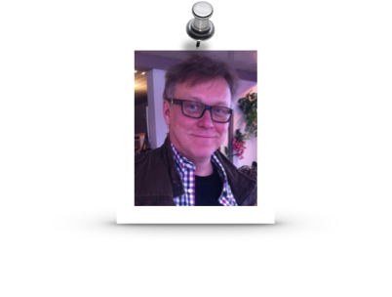

Ayse Tosum
OULU
Burak Turham
OULU
Markku Oivo
OULU
Sira Vegas
UPMadrid
Natalia Juristo
UPMadrid & OULU
Davide Fucci
OULU
Oscar Dieste
UPMadrid
Hakan Erdogmus
CMU

Slide 4
Overall goal
What really matters
For you?
Seminar on UT and TDD
For us?
A Software Engineering Experiment

Slide 5
An Experiment?
It is a type of empirical research
Different kinds of
In this case, it is an experiment with human subjects (= you)
Experiments help us to find out the effects of software engineering technologies in practice
We cannot disclose any further
Risk of bias

Slide 6
Any special requirements?
In general, we have more or less everything under control
E.g.: the eclipse we sent to you is part of the experimental instrumentation
But you can help us out if
Do not discuss the training exercises during the week and
Do not disclose the training exercise to others (including your company mates)
Maybe we can repeat this training in the future

Slide 7
Important clarification
We are going to collect some information from you
Questionnaire answers
Code
These data will be analyzed for scientific purposes, under ethical standards:
We annotate quizzes and code with your IDs, but we cannot trace IDs and names
Company will get from us aggregated information ONLY
The company can decide to share this information, or not

Slide 8
Unit testing (UT)

Slide 9
Open discussion
What is unit testing?

Slide 10
Open discussion
What is unit testing?
The stuff that somebody else
does after you are done coding
and/or
What you do with your code after you are done

Slide 11
Open discussion
What is unit testing?
The stuff that somebody else
does after you are done coding
and/or
What you do with your code after you are done
Not in this sense…

Slide 12
Open discussion
What is unit testing (also)?
A programming philosophy
characterized by the
in-parallel development of test code and production code, not just for QA purposes but also for design

Slide 13
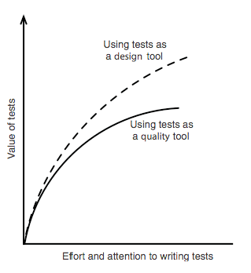
Open discussion
Does this new approach work better?
Not that clear !!

Slide 14
UT & TDD Seminar
Expectations?

Slide 15
We can promise…
A review of good practices on UT
Including test doubles
Mocking cannot be covered
An in-depth introduction to JUnit, the facto standard in UT with Java
Hamcrest matchers??
A reasonable explanation of TDD and TDD strategies
And lots of training exercises

Slide 16
Today
Slicing concepts
Basic JUnit (test classes, methods, assertions)
+ Parameterized tests
+ intermediate JUnit (test cycle and test runners)
3 exercises

Slide 17
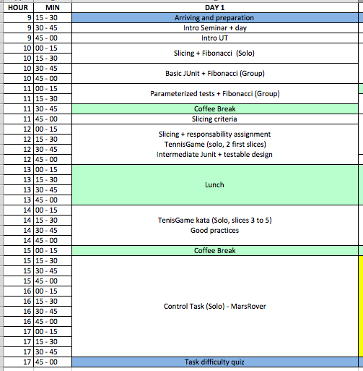
Schedule

Slide 18
Ready?

Slide 19

Recommended book

Slide 20
Slicing

Slide 21
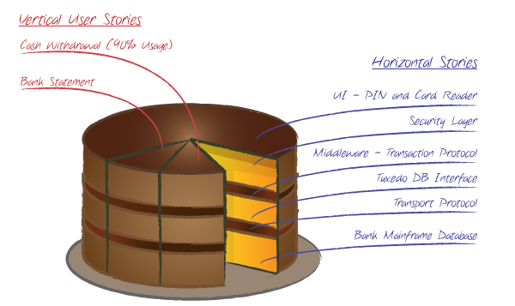
Splitting stories
In agile teams, story splitting is frequent
Vertical slices are preferred
Comply INVEST guidelines
Stories are split to:
Improve understanding, estimation, prioritization
Make progress visible, increased team satisfaction
Get faster feedback
From: www.deltamatrix.com
Notes:
I Independent
N Negotiable
V Valuable
E Estimable
S Sized appropriately or Small
T Testable

Slide 22

A word of warning
Depending on the team’s organization, tasks can be assigned in different ways
Team members have different fields of specialization (e.g.: database, UI, etc.)
Horizontal pieces
Team members are generalists
Vertical slices
UI
Business
Logic
Database

Slide 23
Coding
I assume that you are generalist
Suppose you have been assigned a vertical slice
How would you proceed?
(discussion)

Slide 24
Coding
I assume that you are generalist
Suppose you have been assigned a vertical slice
Is it possible to slice further?

Slide 25
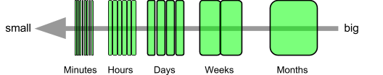
Coding
I assume that you are generalist
Suppose you have been assigned a vertical slice
Is it possible to slice further?
From: Elephant Carpaccio facilitation guide

Slide 26
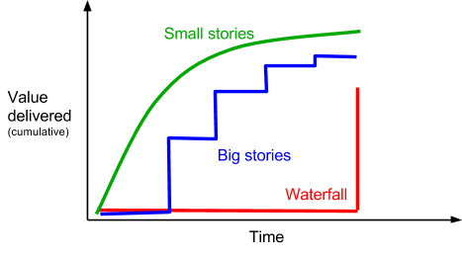
Coding
Stories can be split to trivial levels of complexity
Less up-front design, refactoring
Faster delivery
From: Elephant Carpaccio facilitation guide

Slide 27
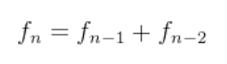
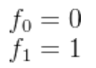
Trivial (but illustrative) example
Task
Develop a procedure to calculate a Fibonacci number n
being:
Thanks: Timo Räty, Elektrobit, Oulu
Before: Kent Beck

Slide 28
Discussion
What are the (thin) user stories here?

Slide 29
Discussion
What are the (thin) user stories here?
Do f(0), f(1), f(n) fit the concept of a (thin) user story?

Slide 30
Discussion
What are the (thinner) user stories here?
Do f(0), f(1), f(n) fit the concept of a (thin) user story?
Depends on what we understand by business value
Taken liberally
Let’s call them slices, to avoid confusion

Slide 31
Trivial (but illustrative) example
Slices
Calculate f(0)
Calculate f(1)
Calculate f(n) (recursive)

Slide 32
Code
/**
* Function that calculates Fibonacci's number (recursive)
* @param n
* @return Fibonacci's number
*/
public static long calculate(int n) {
if (n == 0)
return 0;
if (n == 1)
return 1;
return(calculate(n-1) + calculate(n-2));
}
No defensive programming!

Slide 33
Code (with some defensive elements)
/**
* Function that calculates Fibonacci's number (recursive)
* @param n
* @return Fibonacci's number
*/
if ((n > 92) || (n < 0))
return -1;
if (n == 0)
return 0;
if (n == 1)
return 1;
return(calculate(n-1) + calculate(n-2));
}
I do not advocate defensive programming
(regular) Assertions or contract-based approaches are also possible

Slide 34
Test last approaches

Slide 35
Test last
We all acknowledge that before releasing a US, it has to be tested
Our concern is UT, not integration or system testing
The typical approach is running the tests after the code was complete
1 US → 1 testing session
Test-last approach

Slide 36
Discussion
When USs are further split,
Do we wait to test until the top level US is complete?

Slide 37
Incremental test last
When USs are further split, each slice can be individually tested
Each slice produces a tiny piece of functionality
This functionality is retained throughout subsequent increments
This strategy is called incremental test last

Slide 38
Incremental test-last
Add some functionality
Add a test
[Pass]
Run the test(s)
[Fail]
Debug and fix
[Development stops]

Slide 39
Incremental test last
When USs are further split, each slice can be individually tested
Each slice produces a tiny piece of functionality
This functionality is retained throughout subsequent increments
This strategy is called incremental test last
Only possible with automated tests
Good Practice 1: No production code without test code

Slide 40
JUnit basics

Slide 41
Some facts about JUnit
JUnit is a unit testing framework for Java, created by Eric Gamma (patterns) and Kent Beck (TDD) in 1997
They say it was created in a flight from Zurich to the 1997 OOPSLA in Atlanta ☺
Similar frameworks created for other languages
De facto standard
Still evolving
Latest release: 4.11

Slide 42
Basic Concepts
Assertions, to verify single expected results
Test methods, to verify one single case of a given feature = test case
Test class; typically embodies all test methods for a given class

Slide 43
Assertions
Verify single expected results
fail
assertTrue assertFalse
assertNull assertNotNull
assertEquals
assertArrayEquals
assertSame assertNotSame
Those methods accept an String argument to describe the reason of a failure

Slide 44
Test methods
Defined using the annotation:
@Test
public void <methodName>() { … }

Slide 45
Test methods
Defined using the annotation:
@Test
public void <methodName>() { … }
Mandatory

Slide 46
Test methods
Defined using the annotation:
@Test
public void <methodName>() { … }
GP2: Test method names must be meaningful; they should provide a clear idea what the test is for

Slide 47
Test methods
Defined using the annotation:
@Test
public void <methodName>() { … }
GP2: Test method names must be meaningful; they should provide a clear idea what the test is for
GP3: Focus on behavior, not implementation

Slide 48
Test methods
Defined using the annotation:
@Test
public void <methodName>() { … }
GP2: Test method names must be meaningful; they should provide a clear idea what the test is for
GP3: Focus on behavior, not implementation
In general, these good practices are independent of the UT framework (Junit, in this case)

Slide 49
Test methods
Defined using the annotation:
@Test
public void <methodName>() { … }
Test methods can contain any code:
Local variables, calculations
Control structures, call to helper methods
Etc.
In particular, they contain one or several assertions

Slide 50
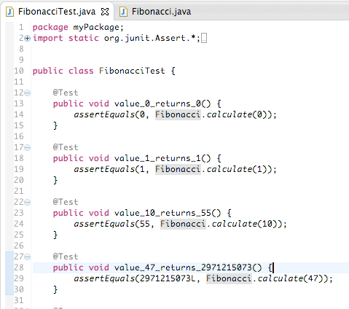
Typical test class structure
By convention, the test class for class <Class> is <ClassTest>
Test method, annotated with @Test
Assertion (one of several kinds of)

Slide 51
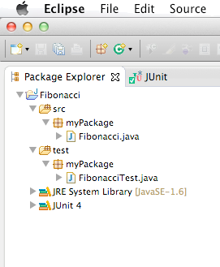
Typical code organization
Classes and test classes are located in the same package
Test classes are located under the test folder
JUnit library must be present

Slide 52
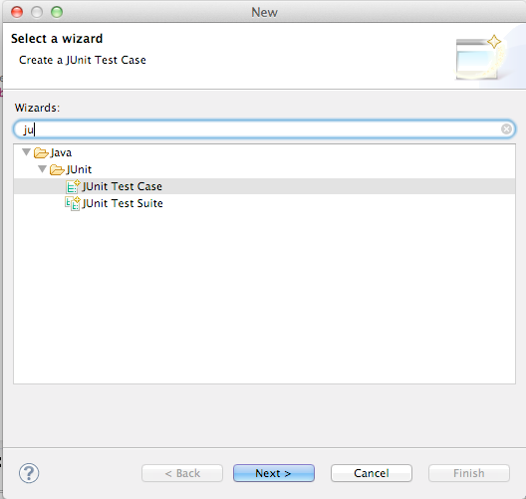
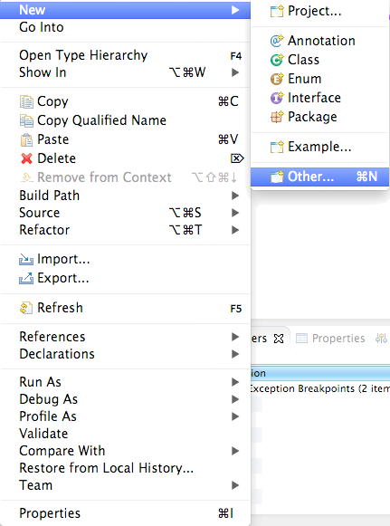
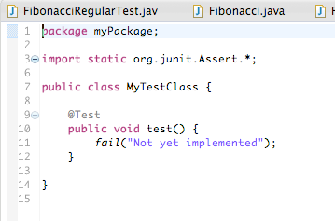
JUnit & Eclipse

Slide 53
One point here…
GP4: Unfinished tests should fail

Slide 54
JUnit basics
Let’s apply these concepts to the Fibonacci example

Slide 55
Summary of good practices
GP0: 100% test coverage is not the goal
GP1: No production code without test code
GP2: Test method names must be meaningful
GP3: Focus on behavior, not implementation
GP4: Unfinished tests should fail

Slide 56
Target

Slide 57
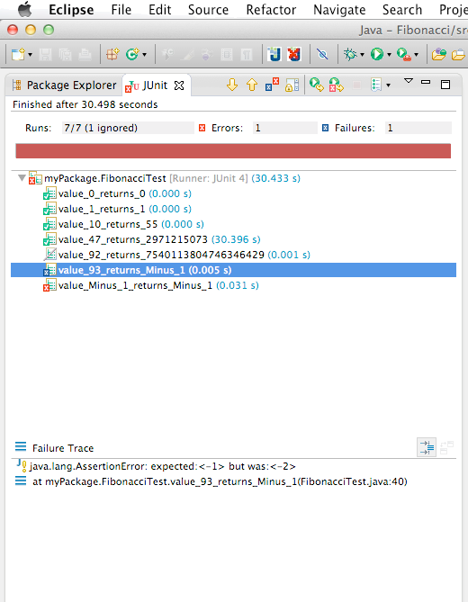
JUnit test method execution window
Status
Red/Green bar
Run tests, results (success, failure, ignore, error) and execution time
Failure trace, including failing assertion information

Slide 58
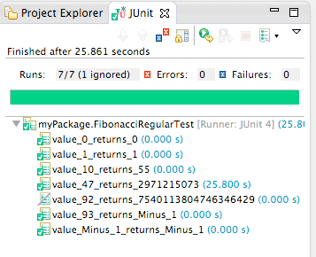
Results for Fibonacci class
This tests takes almost 30 seconds!

Slide 59
Results for Fibonacci class
This tests takes almost 30 seconds!
GP5: Test should provide fast feedback

Slide 60
Results for Fibonacci class
Try this one!
(right now, this test is decorated with @Ignore besides @Test, to avoid test execution)

Slide 61
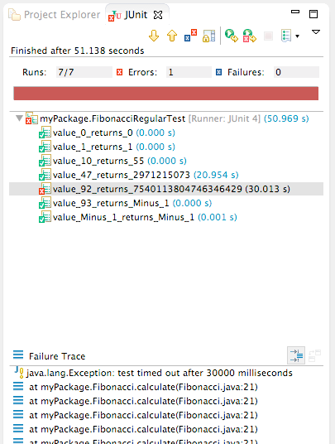
Results for Fibonacci class
Don’t lose time. It will take quite a while to finish
We can use a trick provided by JUnit to avoid long lasting cases:
@Test (timeout = <miliseconds>)

Slide 62
Results for Fibonacci class
However, long lasting test is a sign of poor (production code) design
(there are exceptions; see test doubles later)
GP6: Design should be testable (refactor if needed)
(there are many flavors; see later)

Slide 63
Trivial (but illustrative) example
Slices
Calculate f(0)
Calculate f(1)
Calculate f(n) (recursive)
Refactor f(n) (iterative)

Slide 64
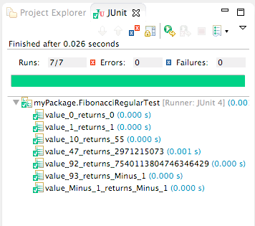
Results for Fibonacci class
Big difference!

Slide 65
Summary of good practices
GP0: 100% test coverage is not the goal
GP1: No production code without test code
GP2: Test method names must be meaningful
GP3: Focus on behavior, not implementation
GP4: Unfinished tests should fail
GP5: Tests should provide fast feedback
GP6: Design should be testable (refactor if needed)

Slide 66
Parameterized tests
Not the right moment, but definitely the right place (Fibonacci example)

Slide 67
Parameterized tests
Do not pay attention to some details

Slide 68
Parameterized tests
Do not pay attention to some details
Parameterized tests are a way to remove duplications when tests differ in small details
Input/output combinations, for instance
Test cases’ values can be defined in an array that is passed in turn to a test method
Only 1 test method need to be written

Slide 69
Parameterized tests need a special test runner
@RunWith(Parameterized.class)
public class FibonacciParameterizedTest {
private int n;
private long result;
public FibonacciParameterizedTest (int n, long result) {
this.n = n;
this.result = result;
}
@Parameters
public static Collection<Object[]> myData() {
return Arrays.asList(new Object[][] { {0, 0},
{1, 1},
{10, 55},
{47, 2971215073L},
{92, 7540113804746346429L},
{93, -1},
{-1, -1} });
}
@Test
public void checkValue() {
assertEquals(result, Fibonacci.calculate(n));
}
}

Slide 70
The test class doesn’t have any difference to previous examples
@RunWith(Parameterized.class)
public class FibonacciParameterizedTest {
private int n;
private long result;
public FibonacciParameterizedTest (int n, long result) {
this.n = n;
this.result = result;
}
@Parameters
public static Collection<Object[]> myData() {
return Arrays.asList(new Object[][] { {0, 0},
{1, 1},
{10, 55},
{47, 2971215073L},
{92, 7540113804746346429L},
{93, -1},
{-1, -1} });
}
@Test
public void checkValue() {
assertEquals(result, Fibonacci.calculate(n));
}
}

Slide 71
@RunWith(Parameterized.class)
public class FibonacciParameterizedTest {
private int n;
private long result;
public FibonacciParameterizedTest (int n, long result) {
this.n = n;
this.result = result;
}
@Parameters
public static Collection<Object[]> myData() {
return Arrays.asList(new Object[][] { {0, 0},
{1, 1},
{10, 55},
{47, 2971215073L},
{92, 7540113804746346429L},
{93, -1},
{-1, -1} });
}
@Test
public void checkValue() {
assertEquals(result, Fibonacci.calculate(n));
}
}
Parameters are defined in a public static method

Slide 72
@RunWith(Parameterized.class)
public class FibonacciParameterizedTest {
private int n;
private long result;
public FibonacciParameterizedTest (int n, long result) {
this.n = n;
this.result = result;
}
@Parameters
public static Collection<Object[]> myData() {
return Arrays.asList(new Object[][] { {0, 0},
{1, 1},
{10, 55},
{47, 2971215073L},
{92, 7540113804746346429L},
{93, -1},
{-1, -1} });
}
@Test
public void checkValue() {
assertEquals(result, Fibonacci.calculate(n));
}
}
The test runner instantiates the test class and assigns in turn each set of values to the test class’ attributes

Slide 73
@RunWith(Parameterized.class)
public class FibonacciParameterizedTest {
private int n;
private long result;
public FibonacciParameterizedTest (int n, long result) {
this.n = n;
this.result = result;
}
@Parameters
public static Collection<Object[]> myData() {
return Arrays.asList(new Object[][] { {0, 0},
{1, 1},
{10, 55},
{47, 2971215073L},
{92, 7540113804746346429L},
{93, -1},
{-1, -1} });
}
@Test
public void checkValue() {
assertEquals(result, Fibonacci.calculate(n));
}
}
The test methods run normally

Slide 74
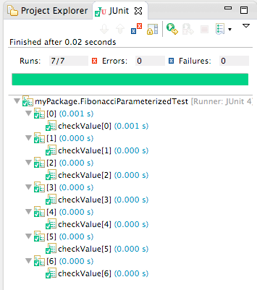
Results for Fibonacci class
Feedback references the array index, not the test method name

Slide 75
Slicing criteria
New example: TennisGame

Slide 76
Up-front design
Which classes?

Slide 77
Up-front design
Which classes?
Game
Player
1
2

Slide 78
Up-front design
Which classes?
Responsibility assignment?
Game
Player
1
2

Slide 79
Up-front design
Which classes?
Responsibility assignment?
Player→ store points, report player score
Game → report game score
Game
getScore()
Player
addPoint()
getScore()
1
2

Slide 80
List of slices (I have some concerns about order)
getScore (love-love, upon init)
getScore (fifteen-forty cases)
getScore (deuce)
getScore (advantage)
getScore (someone wins)

Slide 81
List of slices
getScore (love-love, upon init)
getScore (fifteen-forty cases)
getScore (deuce)
getScore (advantage)
getScore (someone wins)
Let’s start with these two.
DO NOT create test cases for the 2nd slice

Slide 82
JUnit intermediate concepts

Slide 83
JUnit execution cycle
Select a test runner & create a new instance of the test(s) class(es)
Invoke any setup method(s) on the test class
Run test method(s)
Invoke any teardown method(s) on the test class
Delegate to test runner
Setup
Run
Teardown
A.K.A. setup-exercise-verify-teardown cycle

Slide 84
Test runner selection
A test runner is the class to which JUnit delegates test execution
There are several built-in test runners
JUnit4.class
Parametrized.class
Suite.class
They are subclasses of org.junit.runner.Runner
Custom runners can be created
The test runner is selected using the @RunWith(<test runner>) annotation

Slide 85
Test runner selection
A test runner is the class to which JUnit delegates test execution
There are several built-in test runners
JUnit4.class
Parametrized.class
Suite.class
They are subclasses of org.junit.runner.Runner
Custom runners can be created
The test runner is selected using the @RunWith(<test runner>) annotation
Default; explicit definition is not required

Slide 86
Test runner selection
A test runner is the class to which JUnit delegates test execution
There are several built-in test runners
JUnit4.class
Parametrized.class
Suite.class
They are subclasses of org.junit.runner.Runner
Custom runners can be created
The test runner is selected using the @RunWith(<test runner>) annotation
This test runner is used with parameterized tests

Slide 87
Test runner selection
A test runner is the class to which JUnit delegates test execution
There are several built-in test runners
JUnit4.class
Parametrized.class
Suite.class
They are subclasses of org.junit.runner.Runner
Custom runners can be created
The test runner is selected using the @RunWith(<test runner>) annotation
We miss this one; we proceed immediately

Slide 88
Test runner selection
A test runner is the class to which JUnit delegates test execution
There are several built-in test runners
JUnit4.class
Parametrized.class
Suite.class
They are subclasses of org.junit.runner.Runner
Custom runners can be created
The test runner is selected using the @RunWith(<test runner>) annotation
There are graphical versions for IDEs

Slide 89
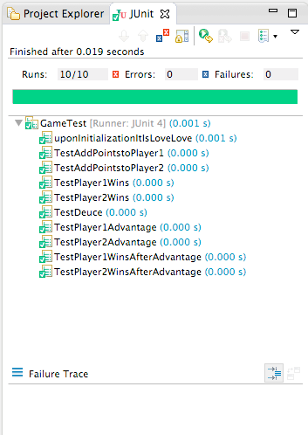
Eclipse graphical built-in test runner

Slide 90
Test suites
A slice may affect several production classes/methods
Several test classes/methods need to be run to make sure the changes didn’t break any existing functionality
Regression testing
It is tedious to perform regression testing manually

Slide 91
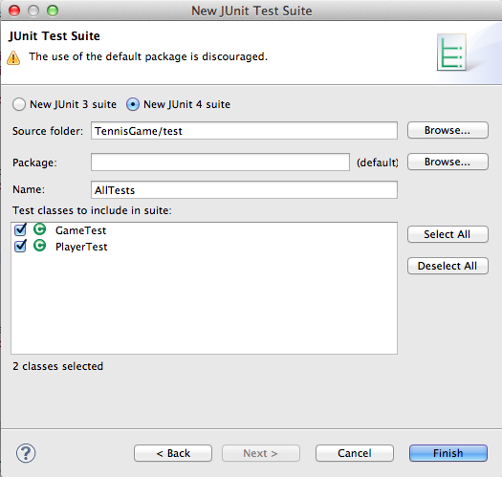
Test suites
Test suites specify a set of test classes/methods that should be run together
The easiest way to create a test suite is using Eclipse’s wizards

Slide 92
Test suites
Manually is not complex either
Test runner definition
import org.junit.runner.RunWith;
import org.junit.runners.Suite;
import org.junit.runners.Suite.SuiteClasses;
@RunWith(Suite.class)
@SuiteClasses({ GameTest.class, PlayerTest.class })
public class AllTests {
}

Slide 93
Test suites
Manually is not complex either
import org.junit.runner.RunWith;
import org.junit.runners.Suite;
import org.junit.runners.Suite.SuiteClasses;
@RunWith(Suite.class)
@SuiteClasses({ GameTest.class, PlayerTest.class })
public class AllTests {
}
Classes to include in the test suite

Slide 94
Test suites
Manually is not complex either
import org.junit.runner.RunWith;
import org.junit.runners.Suite;
import org.junit.runners.Suite.SuiteClasses;
@RunWith(Suite.class)
@SuiteClasses({ GameTest.class, PlayerTest.class })
public class AllTests {
}
Do not put code here…

Slide 95
JUnit execution cycle
Select a test runner & create a new instance of the test(s) class(es)
Invoke any setup method(s) on the test class
Run test method(s)
Invoke any teardown method(s) on the test class
Delegate to test runner
Setup
Run
Teardown

Slide 96
Setup methods
Help creating test fixtures
A set of objects needed to consistently run the test cases
Defined using the annotations:
@Before
public void <methodName>() { … }
or -
@BeforeClass
static public void <methodName>() { … }

Slide 97
Setup methods
Help creating test fixtures
A set of objects needed to consistently run the test cases
Defined using the annotations:
@Before
public void <methodName>() { … }
or -
@BeforeClass
static public void <methodName>() { … }
Runs before each test method is invoked = runs n times
Runs before any test method is invoked = runs once

Slide 98
JUnit execution cycle
Select a test runner & create a new instance of the test(s) class(es)
Invoke any setup method(s) on the test class
Run test method(s)
Invoke any teardown method(s) on the test class
Delegate to test runner
Setup
Run
Teardown

Slide 99
JUnit execution cycle
Select a test runner & create a new instance of the test(s) class(es)
Invoke any setup method(s) on the test class
Run test method(s)
Invoke any teardown method(s) on the test class
Delegate to test runner
Setup
Run
Teardown

Slide 100
Teardown methods
They are directed to restore the environment to the same condition it was before running the tests
Defined using the annotations:
@After
public void <methodName>() { … }
or -
@AfterClass
static public void <methodName>() { … }

Slide 101
Teardown methods
They are directed to restore the environment to the same condition it was before running the tests
Defined using the annotations:
@After
public void <methodName>() { … }
or -
@AfterClass
static public void <methodName>() { … }
Runs after each test method is invoked = runs n times
Runs after all test methods have been invoked = runs once

Slide 102
Junit intermediate concepts
Let’s apply these concepts to the TennisGame example

Slide 103
Let’s start with the Player class
public class PlayerTestFirstAttempt {
static Player p;
@BeforeClass
static public void createAPlayer() {
p = new Player("P");
}
@Test
public void testLoveUopnInitialization() {
assertEquals("Love", p.getScore());
}
@Test
public void testFifteen() {
p.addPoint();
assertEquals("Fifteen", p.getScore());
}
@Test
public void testThirty() {
p.addPoint();
assertEquals("Thirty", p.getScore());
}
@Test
public void testForty() {
p.addPoint();
assertEquals("Forty", p.getScore());
}
}
Each test method adds one point to a player, so the score goes from love to forty

Slide 104
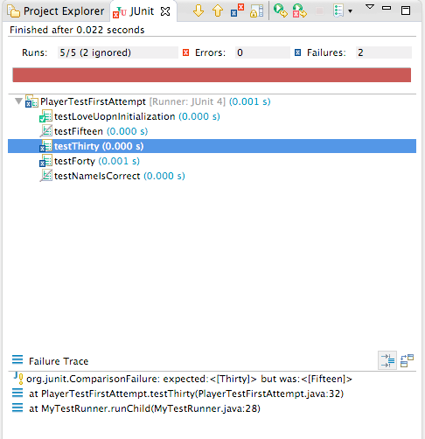
May work, or not…
I added a custom test runner that skips testFifteen()
In real world, reasons may be different (changes in the reflection code between Java 6 and 7)
GP7: Tests should not depend on other tests

Slide 105
Summary of good practices
GP0: 100% test coverage is not the goal
GP1: No production code without test code
GP2: Test method names must be meaningful
GP3: Focus on behavior, not implementation
GP4: Unfinished tests should fail
GP5: Tests should provide fast feedback
GP6: Design should be testable (refactor if needed)
GP7: Tests should not depend on other tests

Slide 106
Correct approach
@RunWith(MyTestRunner.class)
public class PlayerTestSecondAttempt {
Player p;
@Before
public void createAPlater() {
p = new Player("P");
}
@Test
public void testLoveUopnInitialization() {
assertEquals("Love", p.getScore());
}
@Test
public void testFifteen() {
p.addPoint();
assertEquals("Fifteen", p.getScore());
}
@Test
public void testThirty() {
p.addPoint();
p.addPoint();
assertEquals("Thirty", p.getScore());
}
…
This test does not depend on testFifteen()

Slide 107
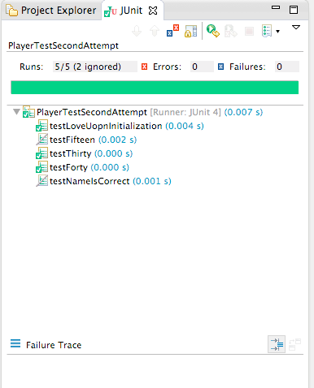
Correct approach
TestThirty() and testForty() are not affected

Slide 108
List of slices
getScore (love-love, upon init)
getScore (fifteen-forty cases)
getScore (deuce)
getScore (advantage)
getScore (someone wins)
Let’s complete these three

Slide 109
Let’s review the tests on Game
I’ve got some tests like:
@Test
public void TestDeuce() {
g.addPoint("Player 1");
g.addPoint("Player 1");
g.addPoint("Player 1");
g.addPoint("Player 2");
g.addPoint("Player 2");
g.addPoint("Player 2");
assertEquals("Deuce", g.getScore());
}
The tests contains too much detail that hides out the test purpose

Slide 110
Let’s review the tests on Game
I’ve got some tests like:
@Test
public void TestDeuce() {
g.addPoint("Player 1");
g.addPoint("Player 1");
g.addPoint("Player 1");
g.addPoint("Player 2");
g.addPoint("Player 2");
g.addPoint("Player 2");
assertEquals("Deuce", g.getScore());
}
The tests contains too much detail that hides out the test purpose
GP8: A test should be readable and meaningful
GP9: Test code could (and should) be refactored

Slide 111
Let’s review the tests on Game
Better approach…
Helper method
private void addPointsToPlayer(String name, int points) {
for (int i = 1; i <= points; i++)
g.addPoint(name);
}
@Test
public void TestDeuce() {
addPointsToPlayer("Player 1”, 3);
addPointsToPlayer("Player 2”, 3);
assertEquals("Deuce", g.getScore());
}

Slide 112
Let’s review the tests on Game
Better approach…but:
GP10: Avoid magic numbers
private void addPointsToPlayer(String name, int points) {
for (int i = 1; i <= points; i++)
g.addPoint(name);
}
@Test
public void TestDeuce() {
addPointsToPlayer("Player 1”, 3);
addPointsToPlayer("Player 2”, 3);
assertEquals("Deuce", g.getScore());
}
Will you remember what it means in a month or so?

Slide 113
Let’s review the tests on Game
Even better:
private void addPointsToPlayer(String name, int points) {
for (int i = 1; i <= points; i++)
g.addPoint(name);
}
private int points(int n) {
return n;
}
@Test
public void TestDeuce() {
addPointsToPlayer("Player 1”, points(3));
addPointsToPlayer("Player 2”, points(3));
assertEquals("Deuce", g.getScore());
}
Gives specific semantics to the numbers

Slide 114
Let’s review the tests on Game
Even better:
private void addPointsToPlayer(String name, int points) {
for (int i = 1; i <= points; i++)
g.addPoint(name);
}
private int points(int n) {
return n;
}
@Test
public void TestDeuce() {
addPointsToPlayer("Player 1”, points(3));
addPointsToPlayer("Player 2”, points(3));
assertEquals("Deuce", g.getScore());
}
Gives specific semantics to the numbers

Slide 115
Tests on Game not yet satisfactory
Do you have something like?
Two reasons to fail
@Test
public void TestPlayer1WinsAfterAdvantage() {
addPointsToPlayer("Player 1", points(4));
addPointsToPlayer("Player 2", points(3));
assertEquals("Player 1 has advantage", g.getScore());
addPointsToPlayer("Player 1", points(1));
assertEquals("Player 1 wins", g.getScore());
}
GP11: A test should have just one reason to fail

Slide 116
Tests on Game not yet satisfactory
This makes more sense:
More options? True, but this is not QA. Do not overkill!
@Test
public void TestPlayer1Advantage() {
addPointsToPlayer("Player 1", points(4));
addPointsToPlayer("Player 2", points(3));
assertEquals("Player 1 has advantage", g.getScore());
}
@Test
public void TestPlayer1WinsAfterAdvantage() {
addPointsToPlayer("Player 1", points(5));
addPointsToPlayer("Player 2", points(3));
assertEquals("Player 1 wins", g.getScore());
}

Slide 117
Last issue in Game class
This is quite weird:
The only reason why we do that is because Player is hardcoded into Game
We need to set Player in a given state
We cannot access Player directly
We cannot replace Player
private void addPointsToPlayer(String name, int points) {
for (int i = 1; i <= points; i++)
g.addPoint(name);
}

Slide 118
Last issue in Game class
Player cannot be replaced by a test double
One of the typical poor design practices that lead to GP6: Design should be testable
Solution is:
Avoid hardcoding; use dependency injection
Extend the original Player into a stub MyPlayer
Bypass the addPoint()method to quickly initialize points

Slide 119
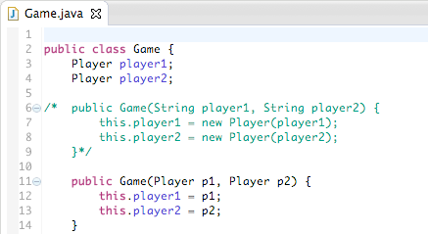
Dependence injection

Slide 120
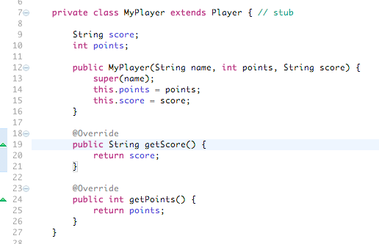
Extend the original Player into a stub MyPlayer

Slide 121
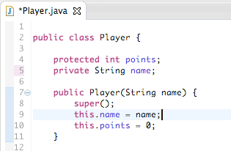
Bypass the addPoint()method to quickly initialize points
Problem here: points is private
Change to protected

Slide 122
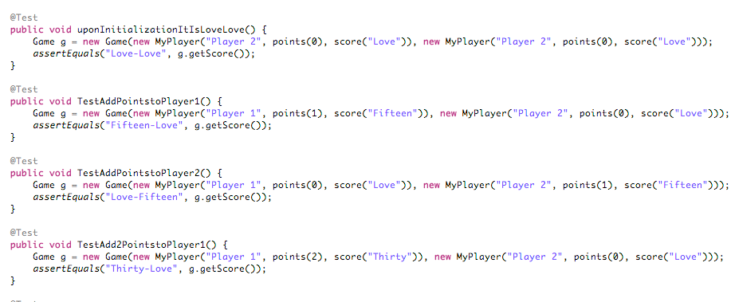
Use with the tests
Less boilerplate, increased control

Slide 123
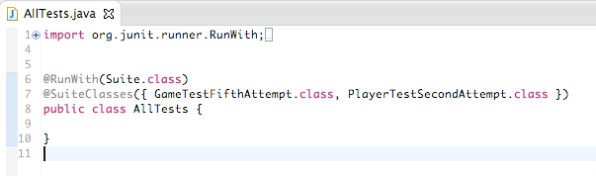
Finally
We can create a test suite to run all tests together

Slide 124
Solo exercise

Slide 125
Summary of good practices
GP0: 100% test coverage is not the goal
GP1: No production code without test code
GP2: Test method names must be meaningful
GP3: Focus on behavior, not implementation
GP4: Unfinished tests should fail
GP5: Tests should provide fast feedback
GP6: see next
GP7: Tests should not depend on other tests
GP8: A test should be readable and meaningful
GP9: Test code should be refactored
GP10: Avoid magic numbers
GP11: A test should have just one reason to fail

Slide 126
Summary of good practices
GP6: Design should be testable (refactor if needed)
Use dependency injection to easily substitute collaborators with test doubles
= use new with care
Use package access instead of private to access attributes from test doubles in the same package

Slide 127
Today
TDD
+slicing criteria
+2 exercises
Also
Basic JUnit (test classes, methods, assertions)
+ Parameterized tests

Slide 128
Test-Driven Development

Slide 129

Recommended book

Slide 130
Introduction
Proposed (/popularized) by Kent Beck in his 2002 book Test-Driven Development by Example
According to the author, TDD is a way of managing fear during programming
Fear makes us tentative, hesitating
Too much up-front design
Unnecessary stuff
Higher complexity
Slow progress

Slide 131
How to avoid fear?
Courage,
meaning do something concrete, quickly
How?
Start simply (KISS, YAGNI)
Write automated tests
Refactor to add design decisions one at a time
TDD follows a test-first approach

Slide 132
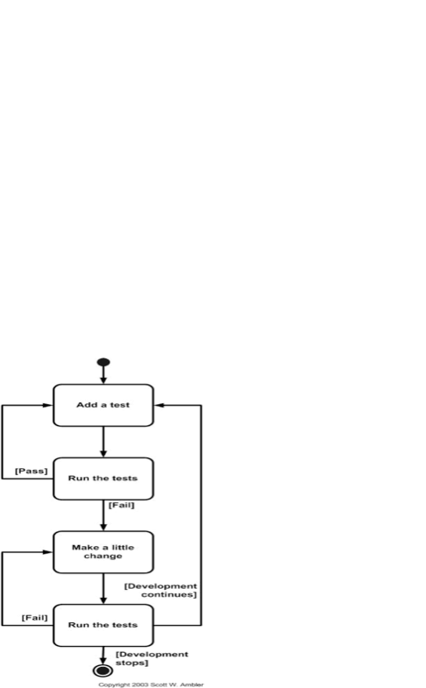
Test-first approach

Slide 133
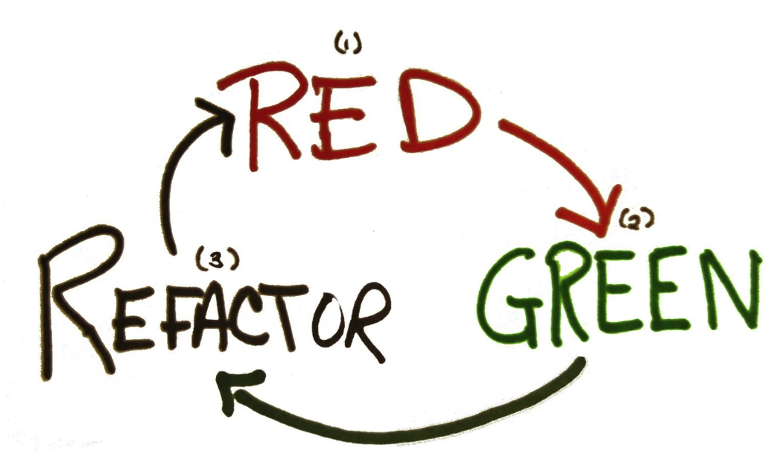
TDD mantra

Slide 134
How to perform the 3 steps?
(1 → 2) Make tests work
(2 → 3) Refactor code
(3 → 1) Move to the next tiny functionality
Let’s start with the last one ☺

Slide 135
(3 → 1) Move to the next tiny functionality
This is really the 1st step
Failing tests reflect something to be done ☺, so it has to be decided beforehand
We have been discussing slicing strategies
Do they apply?

Slide 136
(3 → 1) Move to the next tiny functionality
This is really the 1st step
Tests reflect something to be done ☺, so it has to be decided beforehand
We have been discussing slicing strategies
Do they apply to this context?
Not necessarily…

Slide 137
Slicing strategies in TDD context
The training exercises are toy problems
Slices are very small
The fit the TDD spirit pretty well
However, TDD advocates for even tinier slices
Babysteps
Let’s call them tasks, just to improve communication
Let’s see an example

Slide 138
TennisGame
Incrt’l test last
TDD
getScore →love-love, upon init
getScore →fifteen-forty cases
getScore →love-love
getScore →love-fifteen
getScore ->love-thirty
getScore ->love-forty
Etc.

Slide 139
Slicing strategies in TDD context
TDD
Looks exhausting?
Sure
Sometimes it is clear how to implement a task
Then go ahead
However, that way to proceed makes psychological pressure only on you
Red bars? Go smaller steps
getScore →love-love
getScore →love-fifteen
getScore ->love-thirty
getScore ->love-forty
Etc.

Slide 140
Slicing strategies
Details vs. the “big picture”
Uncertain territory vs. the familiar
Highest values vs. the low-hanging fruits
Happy paths vs. error situations.

Slide 141
Details vs. the “big picture”
Start with the details:
Solve all the small problems before we combine them into a component
Start with the “big picture”:
Solve the design problems – e.g. component structure and them include all the details
Probably best strategy

Slide 142
Uncertain territory vs. the familiar
Exploring uncertain territory
Reduce risk studying the unknown
The familiar
Do what is best understood
Preferred: in many cases bring larger user benefits faster

Slide 143
Highest value vs. the “low-hanging fruits”
Highest value
Valuable features from the user’s perspective, although complex in many cases
“Low-hanging fruits”
Lots of functionality can be built without too much effort
Usually easier to write both tests and code for

Slide 144
Happy paths vs. error situations.
Happy paths
Required behavior
Error situation
Extraordinary? Conditions
They provide users something useful faster

Slide 145
Slicing criteria
Details vs. the “big picture”
Uncertain territory vs. the familiar
Highest values vs. the low-hanging fruits
Happy paths vs. error situations.

Slide 146
(1 → 2) Make tests work
Writing a meaningful test should not be a problem right now
GP3: Focus on behavior, not implementation
There are three typical situations that (may) occur in sequence when implementing a task:
Add missing elements
Fake responses (with constants)
Replace constants with expressions
That may imply some design decision (independently of further refactoring)

Slide 147
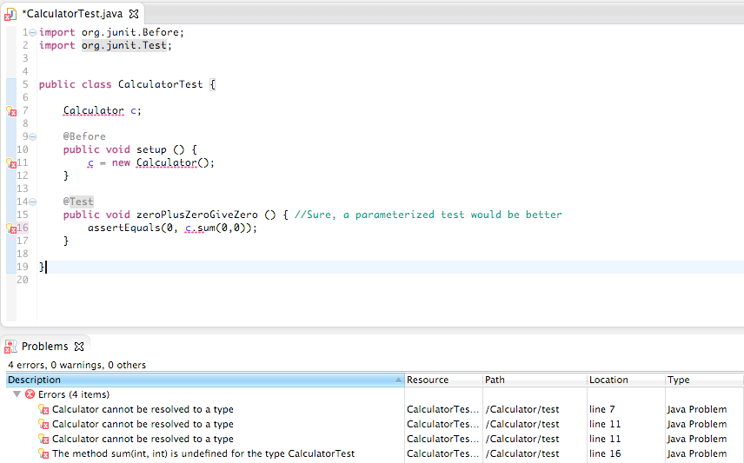
Add missing elements (three images are worth three thousand words)

Slide 148
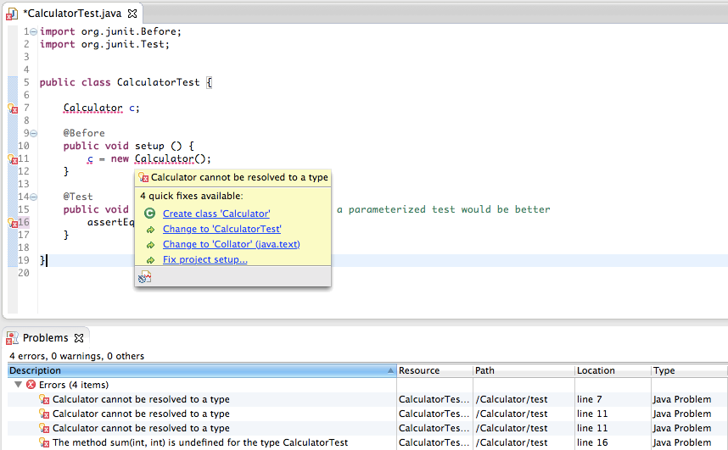
Add missing elements (three images are worth three thousand words)

Slide 149
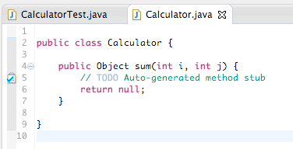
Add missing elements (three images are worth three thousand words)

Slide 150
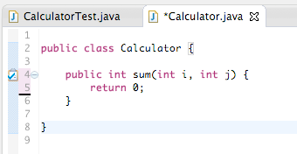
Fake responses (with constants)
Constant

Slide 151
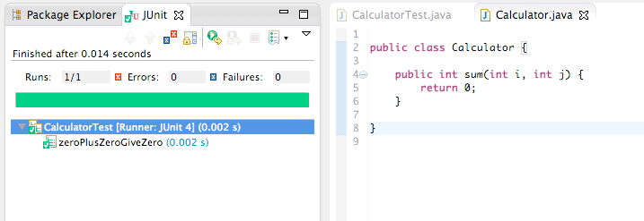
Fake responses (with constants)
Enough to pass the test

Slide 152
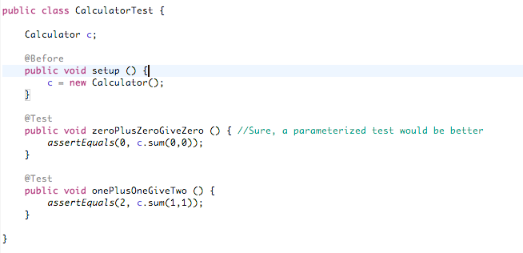
Replace constants with expressions (again pictures)

Slide 153
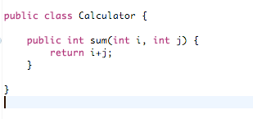
Replace constants with expressions (again pictures)
Abstract when you have 2 or more examples

Slide 154
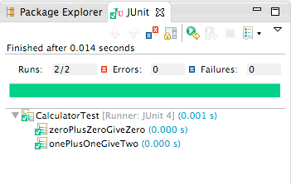
Replace constants with expressions (again pictures)
All previous tests must pass

Slide 155
(1 → 2) Make tests work
OK; but how do I know that my abstraction is correct?
Cannot, in general
Beck recommends triangulation
Create additional tests
Equivalence partitioning approach (and limit values)
DO NOT overkill

Slide 156
(2 → 3) Refactor code
See later, but it is worth mentioning that…
automated tests give us confidence regarding we don’t break anything in the process
(safety net)

Slide 157
TDD benefits and drawbacks
Benefits
Faster feedback
Encourages developers to write code that is easily tested
Creates a thorough test bed
Drawbacks
Developers spend less time writing production code
Quality vs. Productivity
Not really demonstrated so far!

Slide 158
Group exercise
Let’s apply these concepts again to the TennisGame example
Work in babysteps for 10 minutes

Slide 159
Group exercise
Let’s apply these concepts again to the TennisGame example
Let’s start over in the projector

Slide 160
Solo exercise
Let’s apply these concepts to the Game of Life example

Slide 161
Tasks?
Familiar territory
isAlive (…)
kill (…)
makeAlive (…)
Low hanging fruit
Display grid…
Initialize…
Let’s start with this one…

Slide 162
Test doubles

Slide 163
Test doubles
For the sake of understanding:
Dummies, stubs, fakes, spies, mocks, etc.
They share two characteristics:
Extend a base class
Implement minimum functionality, just for testing purposes
Substitute the base class in a collaboration
class
collaborator
test double

Slide 164
Test doubles are useful for
Isolate code under test (e.g.: TennisGame)
Game is not affected by errors in Player when reporting the game score
Game
Player
MyPlayer

Slide 165
Test doubles are useful for
Isolate code under test
Speed up execution
The training exercises does not contain any example
Easy to figure out e.g.: a complex calculation
GP5: Tests should provide fast feedback

Slide 166
Test doubles are useful for
Isolate code under test
Speed up execution
Make execution deterministic
One example in GameOfLife
The output is not predictable
GameOfLife
<new>
Board
initialize()
Random, by requirements
toString()

Slide 167
Test doubles are useful for
Isolate code under test
Speed up execution
Make execution deterministic
One example in GameOfLife
A value can be assigned later, bypassing random init
GP12: Test should not fail at random
MyBoard
class MyBoard extends Board {
…
public void initialize() {
// do nothing
}
}
Board

Slide 168
Test doubles are useful for
NOTICE: a method that’s called from the constructor could result in unexpected behavior. This is just ONE EXAMPLE
Isolate code under test
Speed up execution
Make execution deterministic
One example in GameOfLife
MyBoard
class MyBoard extends Board {
…
public void initialize() {
// do nothing
}
}
Board

Slide 169
Summary of good practices
GP6: Design should be testable (refactor if needed)
Use dependency injection to easily substitute collaborators with test doubles
= use new with care
Use package access instead of private to access attributes from test doubles in the same package
Avoid complex initialization in constructors

Slide 170
Test doubles are useful for
Isolate code under test
Speed up execution
Make execution deterministic
Gain access to hidden information
E.g.: when a methods does not return enough information for testing

Slide 171
Test doubles are useful for
Isolate code under test
Speed up execution
Make execution deterministic
Gain access to hidden information
Simulate special conditions
Easy to figure out: I/O errors, timeouts, etc.

Slide 172
Types of test doubles
Stub
Implements the same interface (or parts of) the base class, without adding logic
Fake
Implements the same interface (or parts of) the base class, changing some functionality
Spy
Fake + reveals some aspects of internal functioning
Mock
Spy + expects some behavior (method calls and parameters)
Stub/Fake queries, Spy observations, Mock actions

Slide 173
Example Stub
We have seen one example before:
MyPlayer in TennisGame
getScore() does not require any processing of points

Slide 174
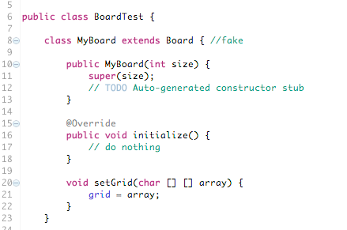
Example Fake
Example in GameOfLife:
Bypasses random initialization
Assigns a custom value to the grid

Slide 175
Example Spy
We don’t have any in the training exercises
It is easy to see how to create one….

Slide 176
Types of UT testing
State-based testing
Request a service, then check the expected results
Stubs, fakes, spies

Slide 177
Types of UT testing
State-based testing
Request a service, then check the expected results
Interaction-based testing
Perform a sequence of interactions between objects, then verify that the sequence of interactions happened as expected
Mocks

Slide 178
Mocks
Mocks are test doubles configured to behave in a certain way under some circumstances
e.g.: imagine a façade for object persistence
e.g.: a given object (say a customer) is updated
Client
Façade
c:Customer
c:= find(ID)
update(…)
store(c)

Slide 179
Mocks
Mocks are test doubles configured to behave in a certain way under some circumstances
e.g.: imagine a façade for object persistence
e.g.: a given object (say a customer) is updated
Client
Façade
c:Customer
2 method calls expected
c:= find(ID)
update(…)
store(c)

Slide 180
Mock
public class MyFacade extends Facade{
int state = 0;
@Override
public Object find(Object ID) {
if(state == 0)
state = 1;
else
state = -1;
return new MyCustomer(…);
}
@Override
public Object update(Object o) {
if(state == 1)
state = 2;
else
state = -1;
}
public boolean isCorrect() {
return state == 2;
}
}
Could be coded by hand
isCorrect()is true if and only if one call to find(), followed by another to update(), took place

Slide 181



Mock
Could be coded by hand
But too time consuming
There are several frameworks available
Outside seminar’s scope

Slide 182
Summary of good practices
GP0: 100% test coverage is not the goal
GP1: No production code without test code
GP2: Test method names must be meaningful
GP3: Focus on behavior, not implementation
GP4: Unfinished tests should fail
GP5: Tests should provide fast feedback
GP6: Design should be testable (refactor if needed) see appropriate
GP7: Tests should not depend on other tests
GP8: A test should be readable and meaningful
GP9: Test code should be refactored
GP10: Avoid magic numbers
GP11: A test should have just one reason to fail
GP12: Tests should not fail at random

Slide 183
JUnit intermediate concepts
When testing that a code raises an exception, specify:
@Test (expected = <exception>.class)

Slide 184
Testable design
(not in this case, but frequent in existing codebases)

Slide 185
Testable design
Some programming decisions affect code testability
Not necessarily bad decisions: e.g.: private fields
Good, actually
Generally speaking, they are related with the inability to substitute classes with test doubles

Slide 186
Reasons?
Hardcoded collaborators
Fields
private
Methods
Final
private
static
Classes
final
Cannot be substituted
Cannot be accessed
Cannot be overridden
Cannot be replaced
Cannot be extended

Slide 187
Reasons?
Hardcoded collaborators → dep. injection
Fields
private → package access
Methods
final → remove
private → package access
static → do not use unless they are
predictable
Classes
final → remove

Slide 188
Special case: Singleton
This is a specially tricky case
Widespread
public class ClassicSingleton {
private static ClassicSingleton instance = null;
protected ClassicSingleton() {
// Exists only to defeat instantiation.
}
public static ClassicSingleton getInstance() {
if(instance == null) {
instance = new ClassicSingleton();
}
return instance;
}
}

Slide 189
Good practices
GP6: Design should be testable (refactor if needed)
Use dependency injection to easily substitute collaborators with test doubles
= use new with care
Use package access instead of private to access attributes from test doubles in the same package
Avoid complex initialization in constructors
Use package access instead of private to access/override methods from test doubles in the same package
Alternatively, expose those methods as public methods in other provider classes
Do not use final methods or classes
Use only static methods if you are sure they do not needed to be substitute by doubles (e.g.: values may be predictable)

Slide 190
TDD on legacy codebases
Let’s work on GildedRose
Please take some time to understand the code structure and purpose
http://tinyurl.com/pdgdmu5

Slide 191
TDD on legacy code

Slide 192

Recommended book

Slide 193
TDD with existing codebases
The RED-GREEN-refactor strategy cannot be applied directly
Touching existing code is necessary
Modifying the code may introduce unintended changes to the existing functionality
Even if the new code passes the new tests, we are never sure what happened with the legacy code
Fear

Slide 194
TDD with existing codebases
A tentative process to apply TDD could be
Identify the change point in the legacy code
Write a test that reflects the new functionality to add
Identify the area affected by the changes (the inflection point)
Cover the area
Write characterization tests
Make changes
Make sure all tests pass
Refactor

Slide 195
Characterization tests
Tests whose purpose is helping in the understanding of the legacy code
The characterization tests
Describe the current functionality
Give confidence that the changes do not break anything

Slide 196
TDD with existing codebases
Example
Identify the change point in the legacy code

Slide 197
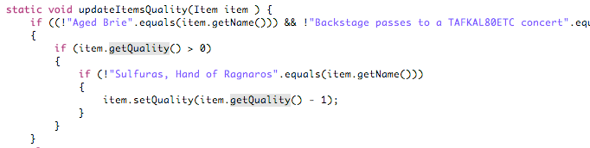
Change point
Quality of conjured items need to be changed here

Slide 198
TDD with existing codebases
A tentative process to apply TDD could be
Identify the change point in the legacy code
Write a test that reflects the new functionality to add

Slide 199
Test for the functionality to add (and make it fail)
@Test
public void conjuredObjectsDecreaseInQualisy2UnitBeforeSellingDate() {
List<Item> items = new ArrayList<Item>();
items.add(new Item("Conjured Mana Cake", 1, 2));
MyGuildedRose.setItems(items);
MyGuildedRose.updateQuality();
assertEquals(0, MyGuildedRose.getQualityOf("Conjured Mana Cake"));
}
Our expectation

Slide 200
TDD with existing codebases
A tentative process to apply TDD could be
Identify the change point in the legacy code
Write a test that reflects the new functionality to add
Identify the area affected by the changes (the inflection point)

Slide 201
Change point
All “normal” items may be affected by changes

Slide 202
TDD with existing codebases
A tentative process to apply TDD could be
Identify the change point in the legacy code
Write a test that reflects the new functionality to add
Identify the area affected by the changes (the inflection point)
Cover the area
Write characterization tests

Slide 203
Characterization tests
@Test
public void degradingObjectsDecreaseInQualisy1UnitBeforeSellingDate() {
List<Item> items = new ArrayList<Item>();
items.add(new Item("+5 Dexterity Vest", 1, 1));
items.add(new Item("Elixir of the Mongoose", 1, 1));
MyGuildedRose.setItems(items);
MyGuildedRose.updateQuality();
assertEquals(0, MyGuildedRose.getQualityOf("+5 Dexterity Vest"));
assertEquals(0, MyGuildedRose.getQualityOf("Elixir of the Mongoose"));
}

Slide 204
TDD with existing codebases
A tentative process to apply TDD could be
Identify the change point in the legacy code
Write a test that reflects the new functionality to add
Identify the area affected by the changes (the inflection point)
Cover the area
Write characterization tests
Make changes

Slide 205
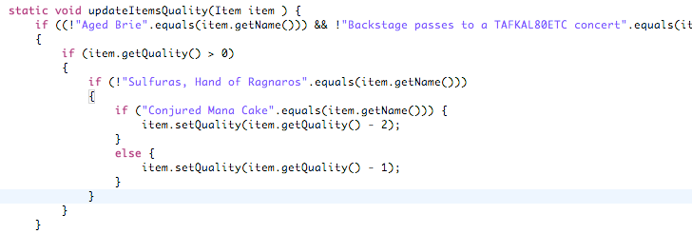
Changes
New if() has been added

Slide 206
TDD with existing codebases
A tentative process to apply TDD could be
Identify the change point in the legacy code
Write a test that reflects the new functionality to add
Identify the area affected by the changes (the inflection point)
Cover the area
Write characterization tests
Make changes
Make sure all tests pass
Refactor

Slide 207
TDD on legacy codebases
Let’s work on GildedRose in group

Slide 208
JUnit advanced concepts
Built-in rules

Slide 209
Built-in rules
JUnit rules allows the definition of work to be done before and after a test case execution.
Including the @Before and @After -notated methods.
In fact, they can replace them
It is a concept similar to the Runner but with the advantage that we can combine multiple rules, making the overall testing more flexible

Slide 210
An example
Rules are defined as public fields and the @Rule annotation
Public class MyTestClass {
@Rule
public TemporaryFolder folder = new TemporaryFolder();
@Test
public void testUsingTempFolder() throws IOException {
File createdFile = folder.newFile("myfile.txt");
File createdFolder = folder.newFolder("subfolder");
// ...
}
}
see https://github.com/junit-team/junit/wiki/Rules

Slide 211
An example
Public class MyTestClass {
@Rule
public TemporaryFolder folder = new TemporaryFolder();
@Test
public void testUsingTempFolder() throws IOException {
File createdFile = folder.newFile("myfile.txt");
File createdFolder = folder.newFolder("subfolder");
// ...
}
}
This class implements the interface org.junit.rules.TestRule
This is a built-in rule
see https://github.com/junit-team/junit/wiki/Rules

Slide 212
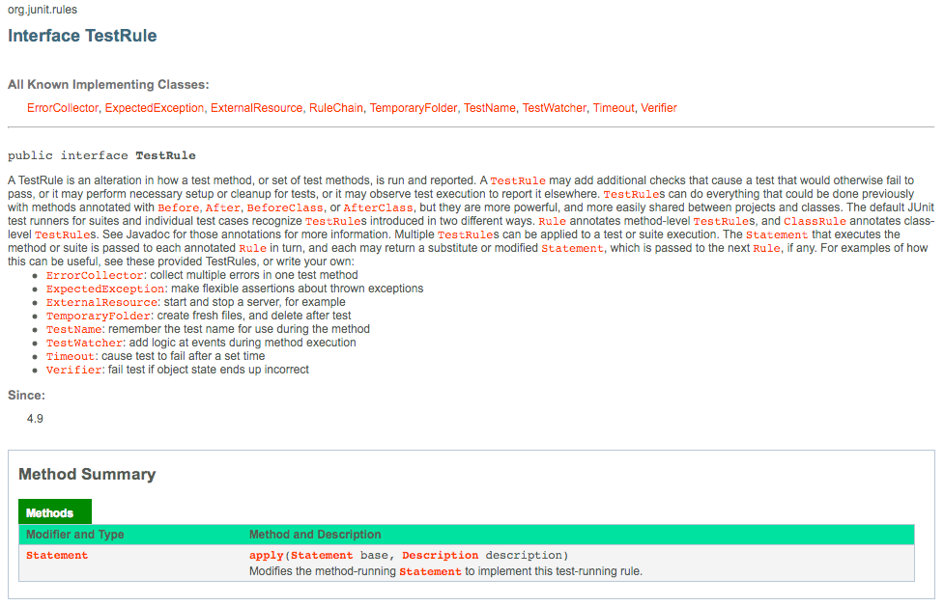
Interface org.junit.rules.TestRule
Just 1 method to implement

Slide 213
Somewhat simpler…
public class MyTestRule implements TestRule {
public Statement apply(final Statement base, Description description) {
return new Statement() {
@Override
public void evaluate() throws Throwable {
System.out.println("before");
try {
base.evaluate();
} finally {
System.out.println("after");
}
}
};
}
}
This code is run before each test is run

Slide 214
Somewhat simpler…
public class MyTestRule implements TestRule {
public Statement apply(final Statement base, Description description) {
return new Statement() {
@Override
public void evaluate() throws Throwable {
System.out.println("before");
try {
base.evaluate();
} finally {
System.out.println("after");
}
}
};
}
}
And this after

Slide 215
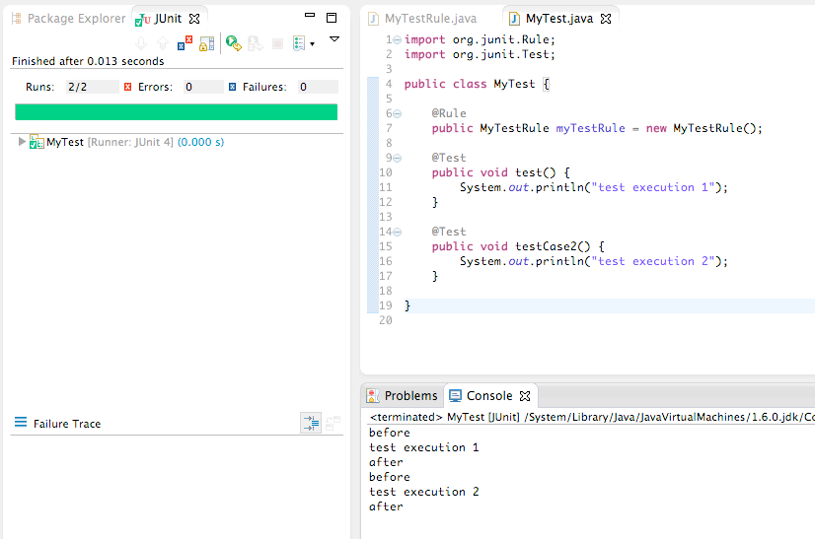
Somewhat simpler…in practice

Slide 216
Rule usage
The rules thus defined can be used with the @Rule annotation
Rule usage

Slide 217
But, what for….?
Rules give you flexibility controlling test execution
e.g. how do you prevent a test running?
right now assumeTrue(<condition>)
e.g. how do you choose a specific fixture for a test?
right now impossible (@Before and @After are for all tests)

Slide 218
Some useful built-in rules Global timeout
public class MyClassTest{
@Rule
public TestRule globalTimeout = new Timeout(2000);
@Test
public void infiniteLoop () {
while (true) {}
}
}

Slide 219
Some useful built-in rules Temporary folder/files
public class MyClassTest{
@Rule
public TemporaryFolder folder = new TemporaryFolder();
@Test
public void testUsingTempFolder() throws IOException {
File createdFile = folder.newFile("myfile.txt");
File createdFolder = folder.newFolder("subfolder");
// ...
}
}

Slide 220
Some useful built-in rules Test cases’ names
public class MyClassTest{
@Rule
public TestName name = new TestName();
@Test
public void testA() {
assertEquals("testA", name.getMethodName());
}
@Test
public void testB() {
assertEquals("testB", name.getMethodName());
}
}

Slide 221
Some useful built-in rules Expected exception
public class MyClassTest{
@Rule
public ExpectedException thrown= ExpectedException.none();
@Test
public void throwsNothing() {
}
@Test
public void throwsNullPointerException() {
thrown.expect(NullPointerException.class);
throw new NullPointerException();
}
@Test
public void throwsNullPointerExceptionWithMessage() {
thrown.expect(NullPointerException.class);
thrown.expectMessage("happened?");
throw new NullPointerException("What happened?");
}
}

Slide 222
Some useful built-in rules Others
https://github.com/junit-team/junit/wiki/Rules

Slide 223
A word of caution
When several rules are active, execution order is not guaranteed
As with test methods; usually works, but not always
Being rules, that could be assumed either
There is a method to specify execution order
Class RuleChain

Slide 224
Class RuleChain
public static class UseRuleChain {
@Rule
public RuleChain chain= RuleChain
.outerRule(new MyRule1())
.around(new MyRule2())
.around(new …);
@Test
public void example() {
assertTrue(true);
}
}
Those rules have to be defined in advance

Slide 225
Solo exercise
MusicPhone

